Slide 1

5-Minute Business Review
Key findings reveal revenue variability, discount impact on margins, delivery inconsistencies
Growth opportunities identified in under-penetrated regions and corporate segment
by Ketan Bande

Slide 2
Executive Summary
Revenue varies significantly by region and category.
Discounts are impacting profit margins beyond optimal thresholds.
Delivery performance inconsistent across modes and regions.
Corporate customers show highest lifetime value.
High growth potential identified in under-penetrated regions.

Slide 3
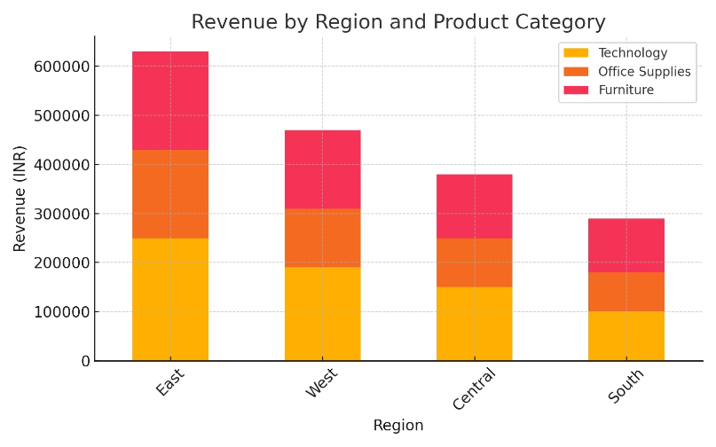
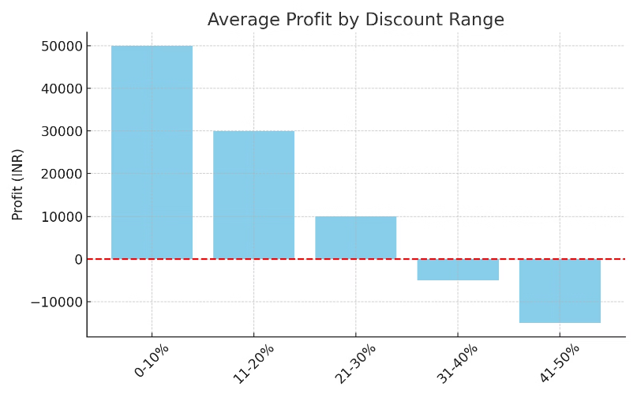
Key Insights – Revenue & Margins
West region outperforms East by 32%
Discounts above 15% significantly erode profit
Technology category leads revenue generation
Office supplies maintain highest margin integrity

Slide 4
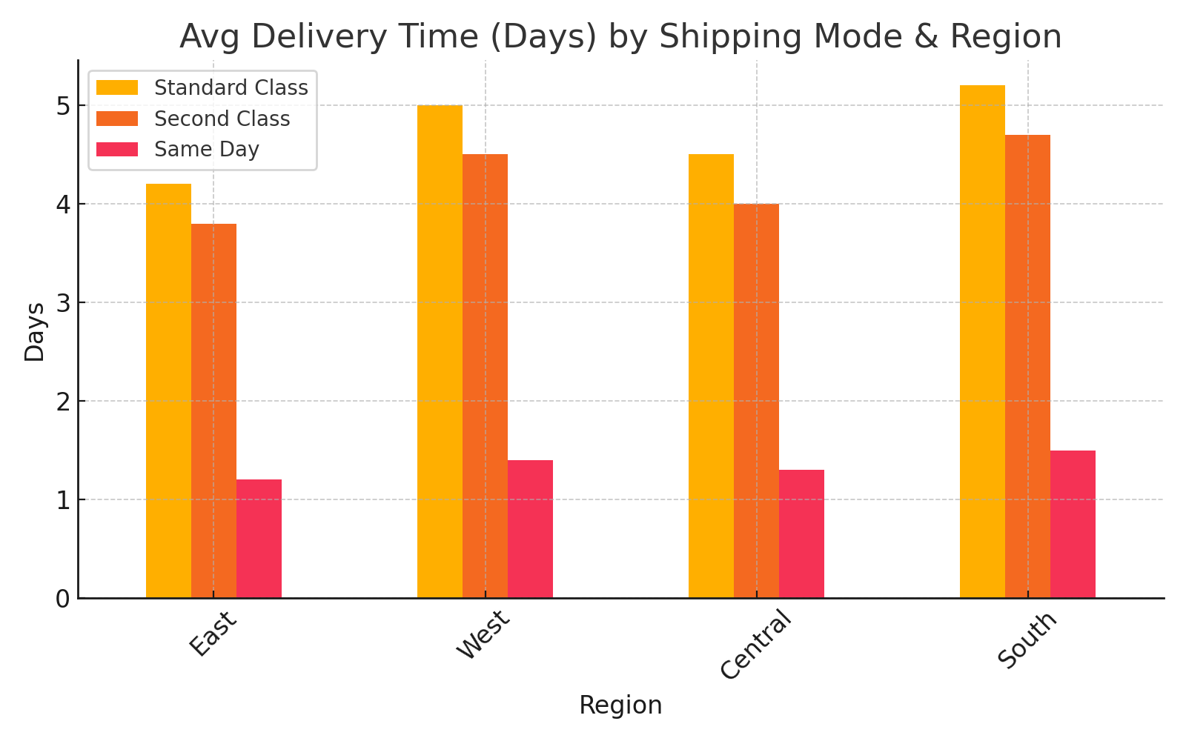
Operational Efficiency

Slide 5
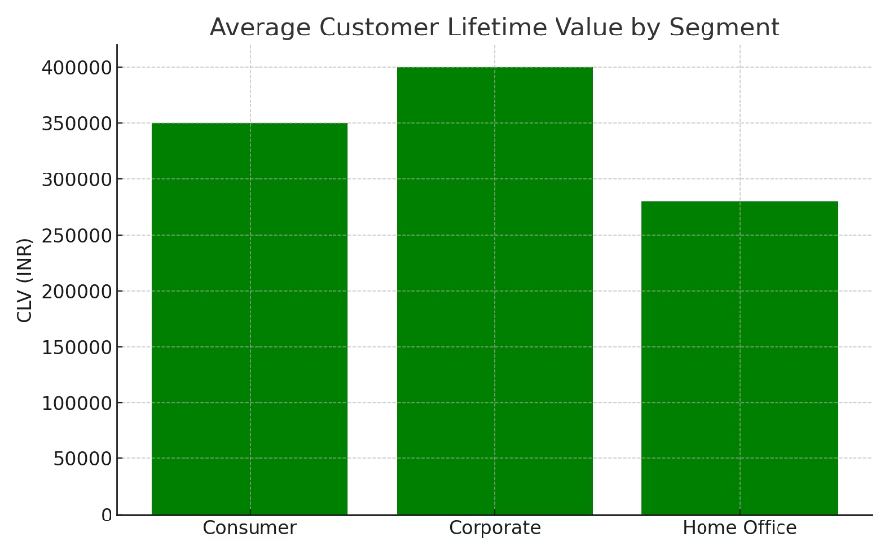



Customer Profiling Takeaway
Corporate
3.5x higher lifetime value
Small Business
Growing 27% annually
Consumer
Highest volume, lowest margin

Slide 6
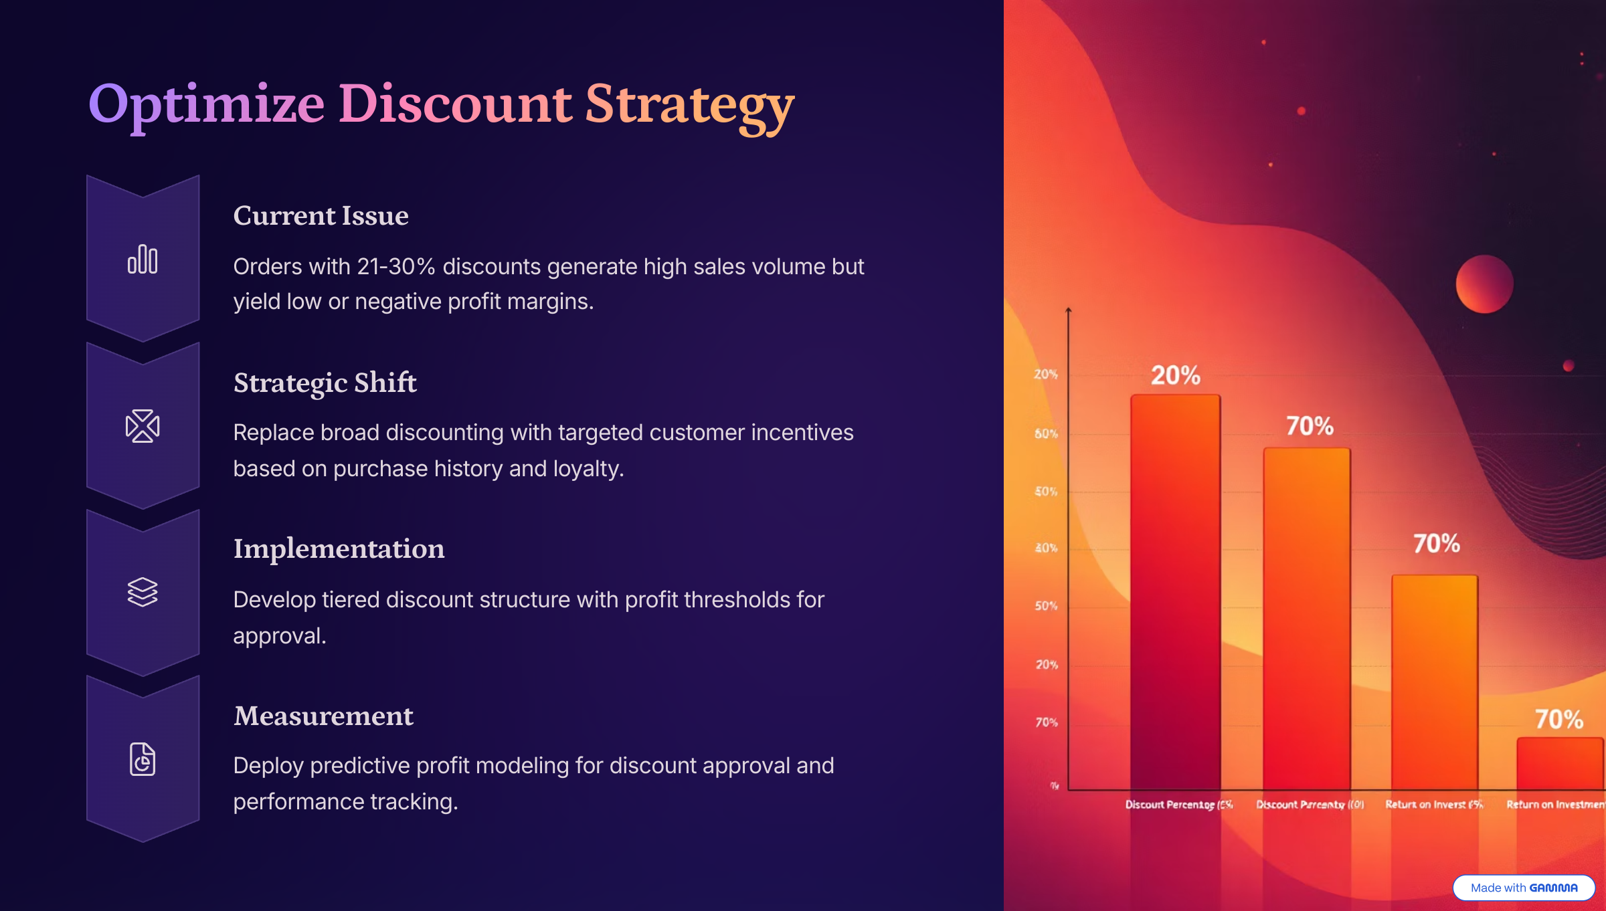

Slide 7
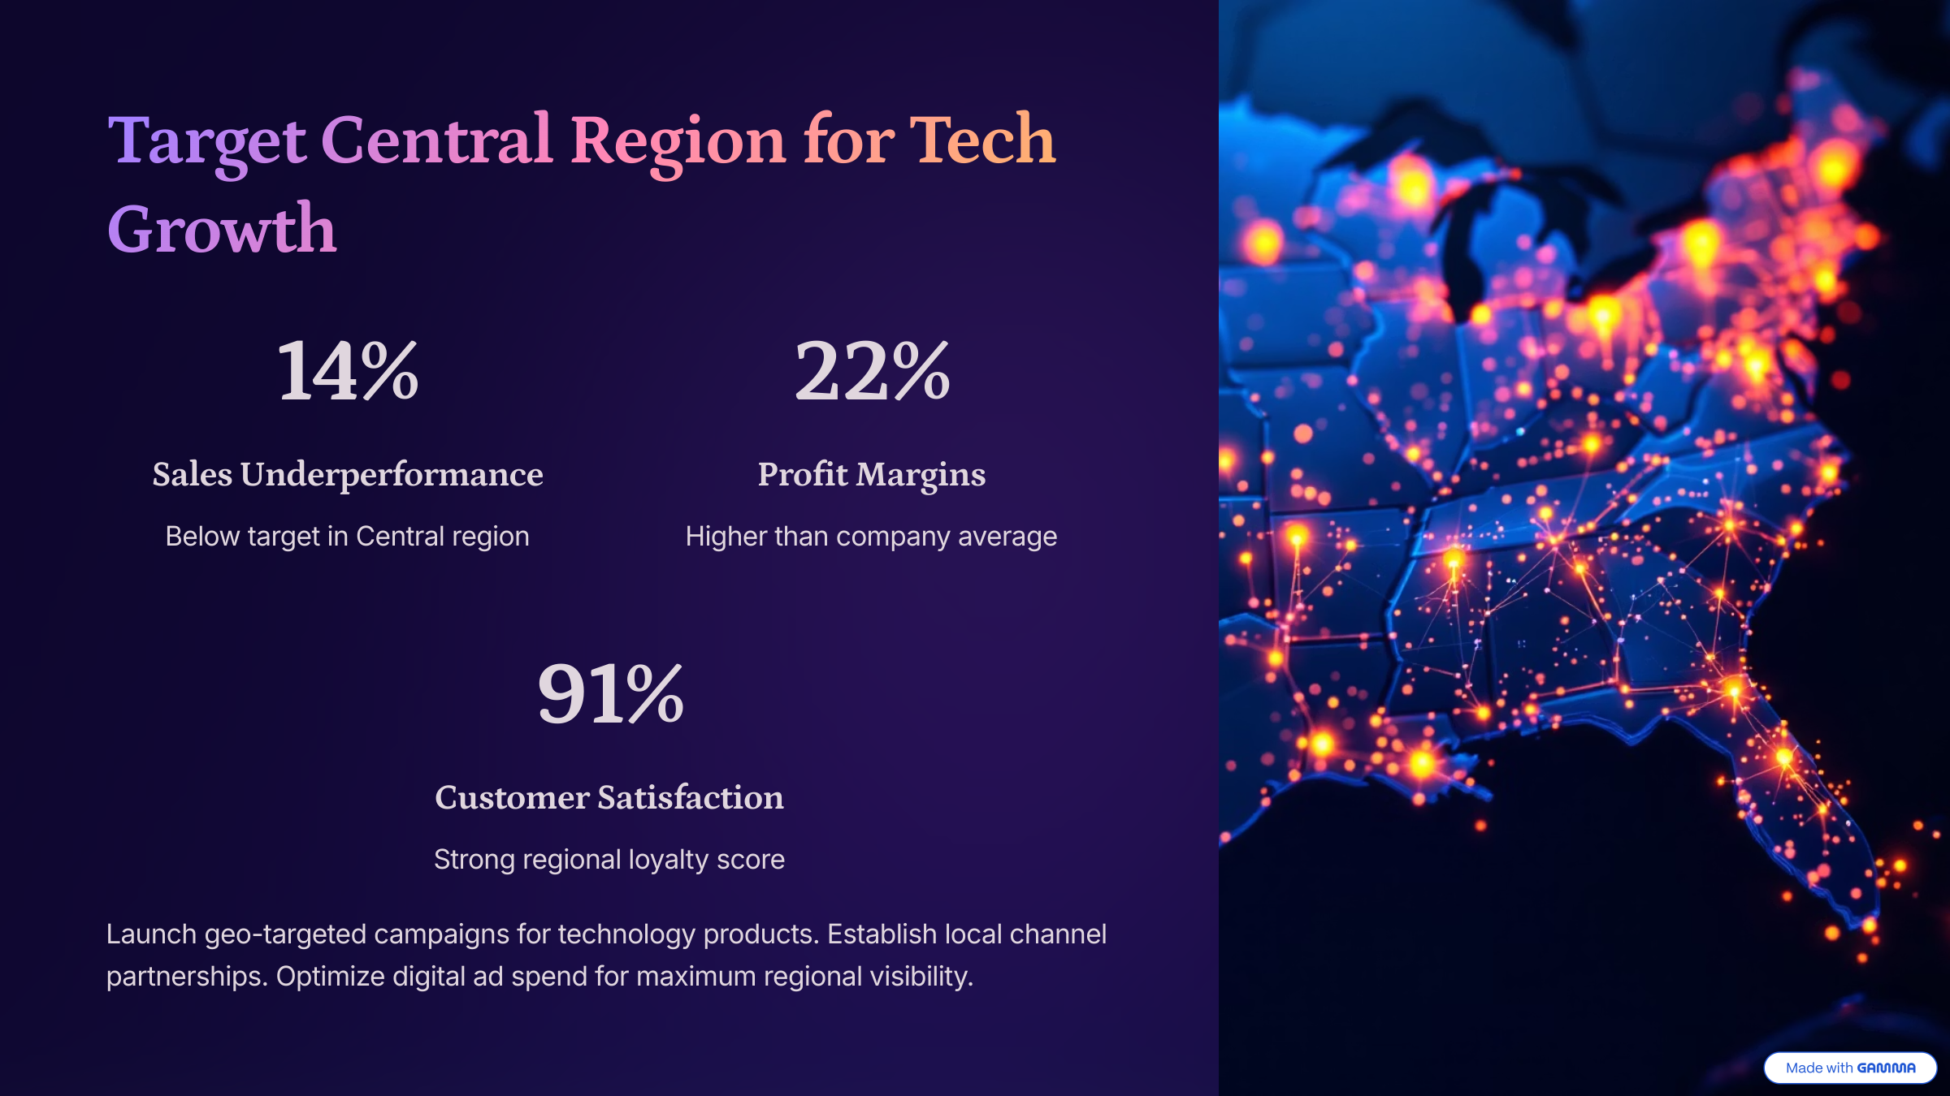

Slide 8
